Slide 1
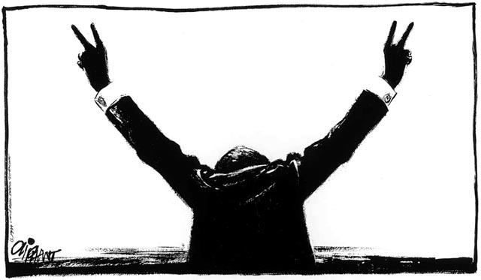
Council of Stellar Management
Internet Spaceships: Serious Business!

Slide 2
What we do
Bi-weekly meetings
Prepare issues based on forum topics
Discuss issues and vote
CSM / CCP meetings
Bring issues to CCP
Discussion
???
Profit!

Slide 3
Does it work?

Slide 4
Does it work?
Total issues to CCP: 184 Denied: 33
Success rate: 82%!
18% Developed within 1 year

Slide 5
Get involved!
Bring up your own issues
Only issues on the Assembly hall can be discussed!
Get CSM support
Run for CSM
Don’t do it for the ‘free trips’
Vote!

Slide 6
Looking ahead
Increased feedback from the CSM to CCP
Feedback request before each CSM/CCP meeting
Iceland meeting scheduled before feature lockdown
Increase CSM/CCP brainstorm opportunities
Monthly QnA

Slide 7
Questions
?

